Slide 1
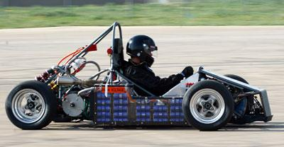
Team 505: SAE Hybrid Vehicle: Battery Box and BMS
9-Oct-18

Slide 2





Team Introductions
William Pisani
ME
Raymond Klouda
ME
Thomas O’Neill
ME
Christopher Fishman
EE
Christian Gaya
CPE

Slide 3
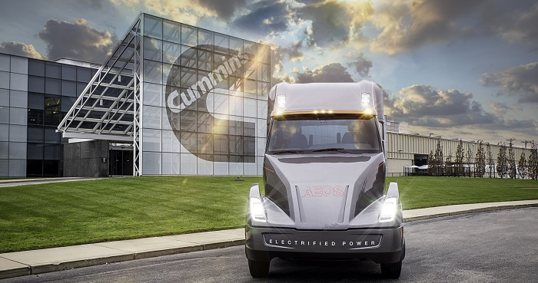

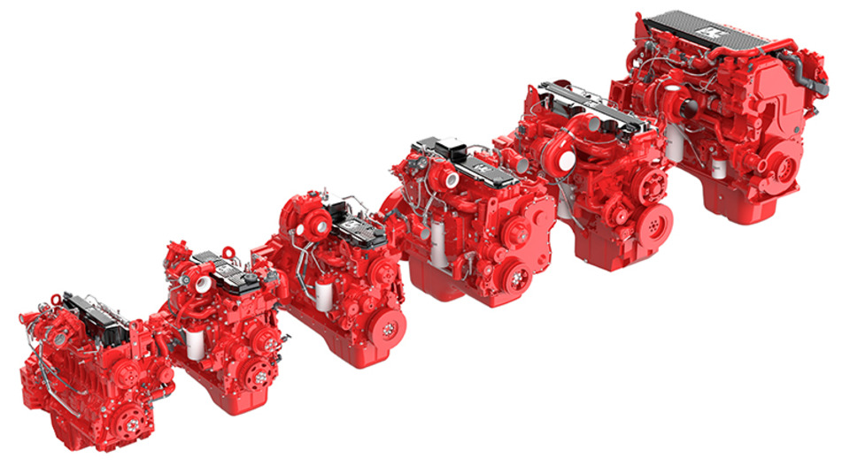
Sponsor
An American Fortune 500 corporation that designs, manufactures, and distributes engines, filtration, and power generation products.
Leading innovation in electrified power on numerous applications especially class 8 semi-trucks.
Raymond Klouda

Slide 4

Objective
The objective of this project is to build a battery box and a battery management system (BMS) for the Society of Automotive Engineers' (SAE) hybrid vehicle competition team.
Raymond Klouda

Slide 5

Project Background
Christian Gaya

Slide 6
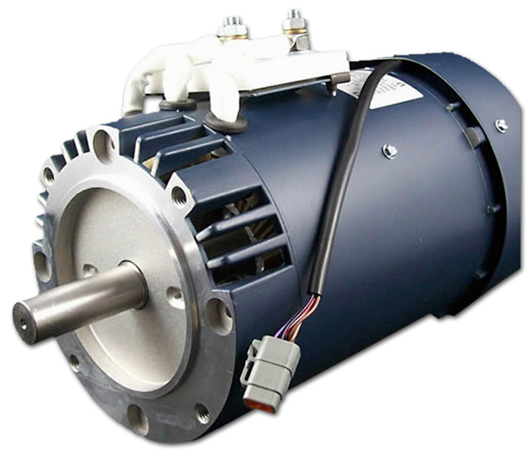
What is a Hybrid Vehicle?
A vehicle that uses more than one form of onboard energy to obtain propulsion
Typical hybrid vehicles are gasoline and electric
The SAE Hybrid vehicle will utilize an internal combustion and an electric motor
Electric motor for hybrid vehicle
Christian Gaya

Slide 7
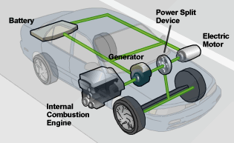
Why use a Hybrid Vehicle?
Gasoline engines require a high engine RPM to output high torque
Electric engines can output a high torque sooner than gasoline engines
Transition between electric to gasoline engines can maximize torque output across a broader range of RPM's
Reduce dependency on gasoline
Depiction of an electric vehicle
Christian Gaya

Slide 8

Project Scope
Raymond Klouda

Slide 9
Project Description
A small model of the battery box and BMS for the SAE hybrid vehicle will be built. A program will also be created that takes in arbitrary vehicle parameters and outputs the appropriate sizing of the battery system.
Key Goals
Compact battery container integrated into frame of vehicle
Environmentally sustainable, waterproof, and thermally insulated
BMS will measure battery charge, control power, and monitor current flow, voltage levels, and temperature
Raymond Klouda

Slide 10
Markets
Primary
SAE hybrid vehicle team
Secondary
Hybrid vehicle manufacturers
Vehicle consumers
Assumptions
Vehicle will have enough room for full-scale battery pack and box
Rulebook will be the same for the year of the competition
Chassis will remain the same for the year of the competition
Raymond Klouda

Slide 11

Customer Needs
Christian Gaya

Slide 12
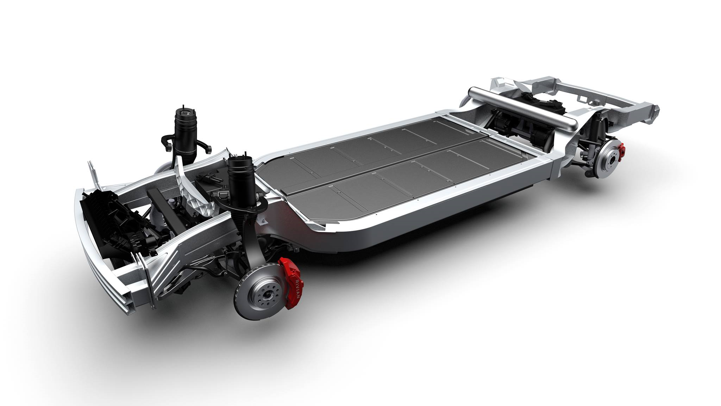
Interpreted Needs
A program should take parameters for a battery and output parameters for a battery box and BMS
The battery box should protect the battery, keep the battery from overheating, and the battery box cannot negatively impact the environment
A small-scale prototype should be created with proper specifications
Electric truck chassis with integrated battery box
Christian Gaya

Slide 13
Interpreted Needs (cont.)
BMS maintains charge control, cell balancing, and monitors power input and output
Battery system for a momentary high-torque boost should be focal point of the BMS system
The battery box and BMS must both adhere to SAE competition guidelines
Christian Gaya

Slide 14

Functional Decomposition
Raymond Klouda

Slide 15
Battery System
Battery Containment
Battery Management System
Support
Monitor
Integrate
Configure
Control
External Forces
Battery Load
Vehicle Chassis
Battery Layout
Temperature
Control
Charge
Current Flow
Voltage Level
Power Output
Batteries
Temperature
Raymond Klouda

Slide 16
Battery Containment
Support
Integrate
Configure
Control
External Forces
Battery Load
Vehicle Chassis
Battery Layout
Temperature
Raymond Klouda

Slide 17
Battery Management System
Monitor
Control
Charge
Current Flow
Voltage Level
Power Output
Batteries
Temperature
Raymond Klouda

Slide 18

Five Most Important Points from this Lecture
Our design should be a scalable-prototype for a hybrid vehicle
Battery box will be designed with safety as the highest priority
Full design should be compact
Programs will be able to scale the battery pack size up and down
Overall project will adhere to SAE competition rulebook
Raymond Klouda

Slide 19

References
Motors. (n.d.). Retrieved October 2, 2018, from http://www.evwest.com/catalog/index.php?cPath=8
Fuel Economy Retrieved October 2, 2018, from https://www.fueleconomy.gov/feg/hybridtech.shtml.
800hp Electric Pickup Retrieved October 3, 2018, from https://www.hardworkingtrucks.com/rivian-reveals-chassis-of-800-hp-electric-pickup/
Notes:
Not this slide will advance on default after 2 seconds. If you would like to change this then go to the transition tab and under timing change the advance slide settings.

Slide 20
Questions

Slide 21
Question/Prompt | Customer Statement | Interpreted Need
Should we build a battery box specific to the current SAE hybrid vehicle? | I want to be able to provide parameters about the battery that the box is holding and get values returned about the size of the box. | A program should take parameters about a battery and output parameters about a battery box.
Should a physical model of the battery box be built? | The main item I'm looking for is the program that will give me values based on the battery. | The main item I'm looking for is the program that will give me values based on the battery.
What should the battery box protect from? | The container should be waterproof, thermally insulated, and environmentally sustainable. | The battery box protects the battery. The battery box prevents overheating of the battery. The battery box does not negatively impact the environment.
What should the BMS do? | The BMS will maintain charge control and cell balancing of the battery in a safe and efficient manner while also monitoring power input and output. | BMS maintains charge control, cell balancing, and monitors power input and output.
What battery are we using to create a BMS for? | Decide on a series of parallel battery. Whichever work best for the motor that is being used in the vehicle. | Battery system for a momentary high-torque boost should be focal point of the BMS system
Should we investigate building our own battery or buying one off the shelf? | Creating your own battery would be very difficult. I recommend buying one off the shelf and using that to create a BMS. | Battery will be purchased.
Do you think there are any restrictions to the battery box and BMS? | The SAE rulebook for the competition should contain all details about how the vehicles must be built. | The battery box and BMS both must adhere to SAE competition guidelines.

Slide 22
Backup Slides
Supporting Slides to the content above.

Slide 24
Standard Shapes
Summary Box
Text box 1
Outlined Text Box

Slide 25


Approved Logos

Slide 26
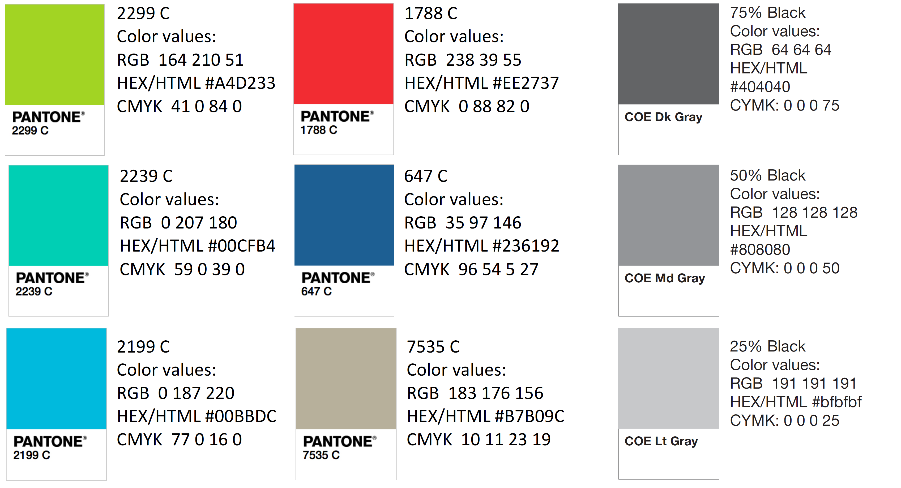
Color Palette

Slide 27
APA Tables
Category 1 | Category 2 | Category 3 | Category 4 | Category 5
Item 1
Item 2
Item 3
Item 4
 | Category 2 |  |  | Category 3
Category 1 | subcategory 1 | subcategory 2 |  | subcategory 1 | subcategory 2
Item 1
Item 2
Item 3
Item 4

